Slide 1

Air pollution monitoring, forecasting and controlling system
BMS College of Engineering
Department of Information Science and Engineering
CAPSTONE PROJECT PHASE -2
Review - III
Batch No:- 25
Project Team Members:
Prateek M Gummaraju (1BM19IS117)
Ruchi Agarwal (1BM19IS133)
Samartha S (1BM19IS219)
Under the Guidance of
Prof. Pallavi B
Assistant Professor
Department of ISE

Slide 2
Agenda
Introduction
Motivation
Objective
Literature Survey
Existing System
Proposed System
Problem Statement
SRS
System Design and Detailed design(DFD, Class diagram etc..)
Methodology
Technology Stack
Implementation
Testing
Results
Conclusion
Future Enhancement
Project Outcome
References

Slide 3
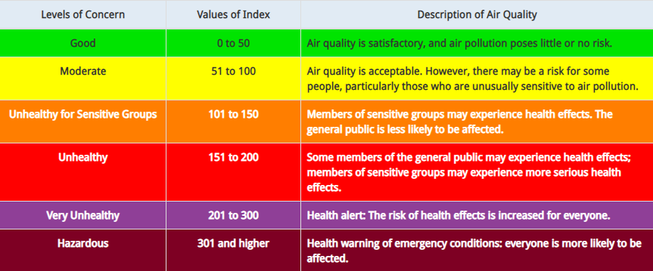
Introduction
Air pollution is defined as the presence of compounds in the atmosphere that are harmful to human beings and other living organisms
Has severe effects on human health - Respiratory issues, lungs and heart problems
Offering a holistic approach to tackle the issue of air pollution by building a device that can monitor air pollution, predict future levels of pollution and also suggest precautionary actions and methods to reduce air pollution

Slide 4
Motivation
Air pollution claims 7 million lives a year making it the most dangerous type of pollution
No present technology that is implemented on a large scale in urban areas
Lack of effective mobile apps
Lack of awareness
Demonstrate the possibility of a device to tackle to this problem which is:
  Cost effective
  Compact
  Easy to use
Help Bengaluru remain the Garden City of India for many years to come

Slide 5
Objectives
Build an IoT system to monitor Air Quality:
  a) Monitor Concentrations of different air pollutants
  b) Measure AQI
Build a model to predict the Air Quality in the near future, using the output of the IoT system as input.
Build a web application to display the real time findings.
Provide analytics on the website, such as current AQI and the forecasted AQI levels
Provide measures to improve Air Quality.
Provide precautionary measures.

Slide 6
Literature Survey
SL.NO | Title of the Paper with Year | Problem Addressed | Authors Approach / Method | Results
1 | “Air pollution monitoring and prediction using IoT” | Air Pollution monitoring and predictions using IoT and sensors | The system employs IoT in conjunction with the machine learning method known as Recurrent Neural Network, specifically Long Short Term Memory (LSTM), to focus on monitoring air contaminants . | For predicting the LSTM is implemented. It has a quick convergence and reduces the training cycles with a good accuracy.
2 | “Air Pollution Monitoring and Prediction Using IoT and Machine Learning” | Air pollution monitoring and forecasting using IoT and ML | They put out a system that employs a number of sensors to measure the concentration of pollutants, and they created a number of ML models to project future pollution levels. | The stacking ensemble model had the highest accuracy and lowest error rate of all the implemented ML models.
3 | “IoT enabled Environmental Air Pollution Monitoring and Rerouting system using Machine learning algorithms” | Air pollution monitoring system used as a rerouting system to find pollution free route | With the collected time series samples, the prediction analysis was done with neural network Multilayer perceptron and support vector machine regression (SVMR) learning algorithm. | The Google Maps API correctly updated the pollution levels, and the advised route was the one with the lowest levels of pollution based on those levels.

Slide 7
Literature Survey
SL.NO | Title of the Paper with Year | Problem Addressed | Authors Approach / Method | Results
4 | “Modelling air quality prediction using a deep learning approach: Method optimization and evaluation” | Deep learning-based modelling of air quality prediction: method improvement and assessment | In this paper , a deep learning framework to predict air quality in the following 24hrs is proposed. A neural network with a temporal sliding long short-term memory extended model (TS-LSTM) | The proposed model had better stability and performances with high correlation coefficient R Squared, compared to the multiple linear regression, support vector, the traditional LSTM, and the LSTME
5 | “Air Quality Index Forecasting using Auto-regression Models” | To forecast the AQI using a Time Series model based on AutoRegression, iNtegrated Differencing and Moving Average | The ARIMA model is employed. Detrending, differencing, and other techniques can be used to change a non-stationary series into a stationary series. | The MSE was 127.00 when auto-regression was used on a time series dataset to forecast the Air Quality Index value seven days in advance.
6 | “Forecasting of Daily Air Quality Index in Delhi” | To forecast the Daily Air Quality index in Delhi to improve the decision making process of the Government and help people take necessary measures. | 3 different models were built; ARIMA, PCR (a combination of PCA and MLR), and a combination of the aforesaid 2 models. | The 3rd model; a combination of PCR and ARIMA, seemed to understand the underlying correlations and patterns between the data points to give the best results.

Slide 8
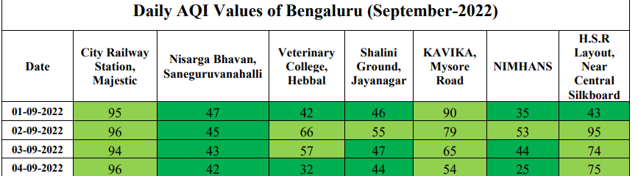
Existing System
Many AQI monitoring systems exist in the market. Many stations are present in Bangalore itself.
However, there are a very few websites that make use of the abundantly available data to forecast the future AQI. Those that do predict the AQI for Bengaluru as a whole. Here’s the problem with that approach:
Interestingly, during our research, we found out that the existing forecasts are pure timeseries based forecasts, without taking into account the external factors.

Slide 9
Proposed System
We propose to build an IoT device using Arduino Uno and several sensors to detect pollutants such as Particulate Matter, Ozone, Carbon Monoxide, etc. Using hourly values of these sensors, we will calculate the sub indices of each pollutant and hence the AQI. AQI will be calculated per day.
Using the AQI data collected from the open source database of CPCB and the IoT device, we aim to build a Machine Learning model to forecast the AQI for the coming few days in Jayanagar region.
Why only this region? Because the AQI at any given time varies all over Bangalore. Hence, if we can model one area accurately, repeating the same for all other areas should be easy.
We have built a website that displays:
  Current AQI
  Forecasted AQI for the next 5 days
  Control Measures and Precautionary Measures

Slide 10
Problem Statement
To build an intelligent device that has the ability to monitor, forecast and control air pollution by leveraging booming technologies like IoT and Data Science.

Slide 11
SYSTEM REQUIREMENT SPECIFICATION
Functional Requirements
Connectivity: Ability of the system to connect and communicate with various sensors, devices and networks
Data collection and storage: Ability of the system to collect data from various sensors, store it and upload it the cloud storage
Integration: Ability to integrate the system with other systems like database and cloud offerings
Alerts and Notifications: Ability to issue the appropriate notifications and alerts for specific conditions.
Ability to analyse the collected data and perform accurate prediction in real time.

Slide 12
Non-functional Requirements
Accuracy: Accuracy is predictions and issuing alerts and notifications should be greater than 97%
Reliability: Ability to ensure consistent and accurate data collection, data analysis and predictions
Usability: Ability to provide an extremely interactive and user friendly interface so that the users can have a good experience using our system
Cost Effectiveness: We want to provide a cost effective solution which is economic and affordable.
Robustness: Ability to work with noisy and corrupted data and filter them out.
Scalability: Ability to handle the enormous amount of data and processing, and also to allow the implementation of more number of devices
Supportability: Ability to perform updates and modifications with ease

Slide 13
Hardware Requirements
Arduino Uno
Breadboard
WiFi module
Connecting Wires
Resistor set
Capacitors
Computer/laptop with internet connection
MQ131 Ozone sensor
MQ135 Air Quality sensor
PM 2.5 Particle sensor
MQ7 CO sensor
DHT11 sensor
Software Requirements
IDEs such as Visual Studio Code, Google Colab and Arduino IDE
Python and libraries like NumPy, Pandas, Tensorflow
MySQL Database
Web hosting service
TeraTerm Software

Slide 14
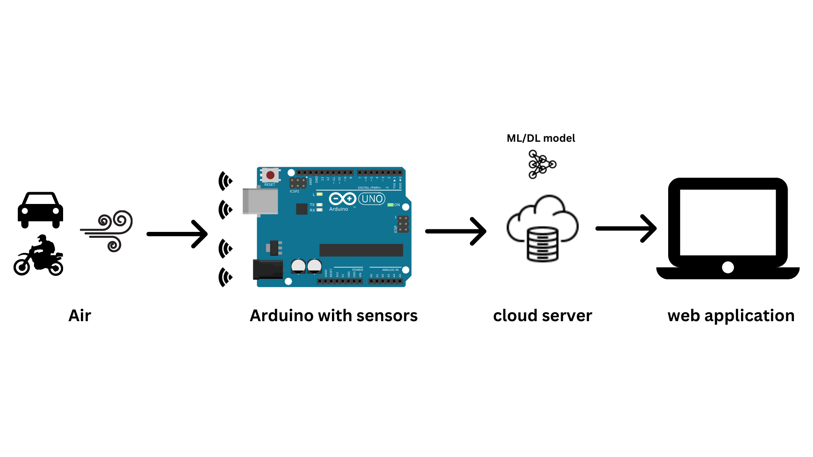
SYSTEM DESIGN
System Architecture

Slide 15
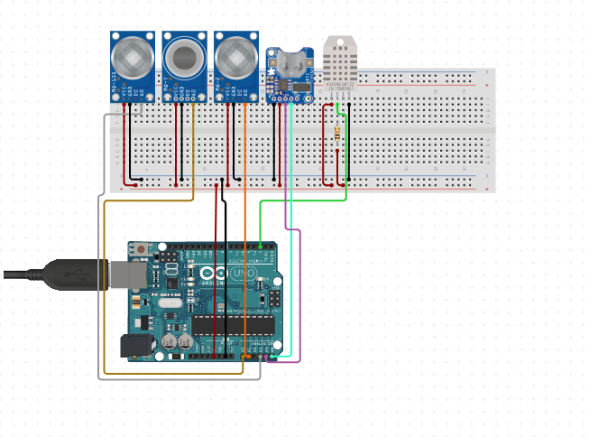
SYSTEM DESIGN
Hardware Implementation

Slide 16
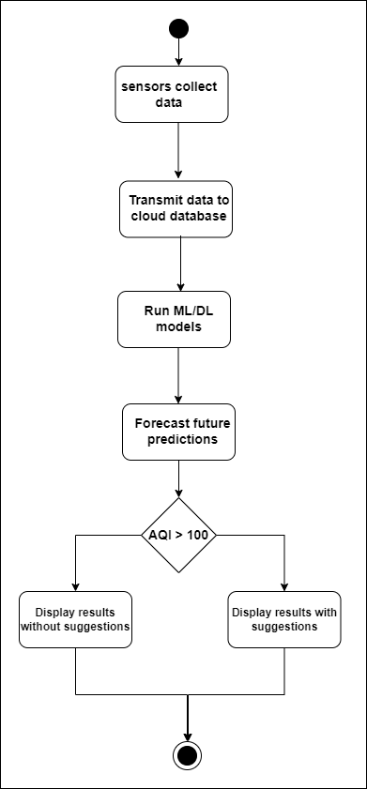
Activity Diagram

Slide 17
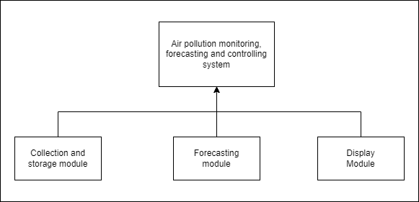
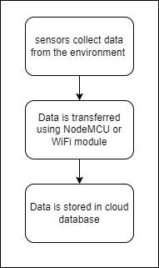
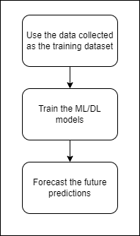
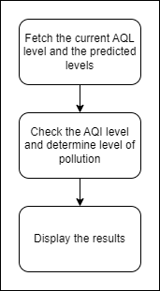
Module Design

Slide 18
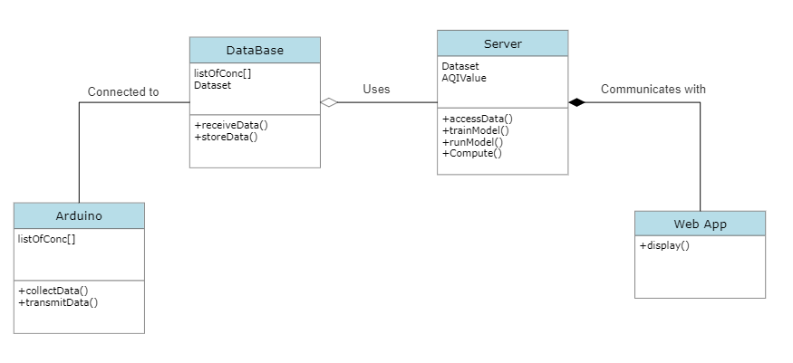
DETAILED DESIGN
Class Diagram

Slide 19
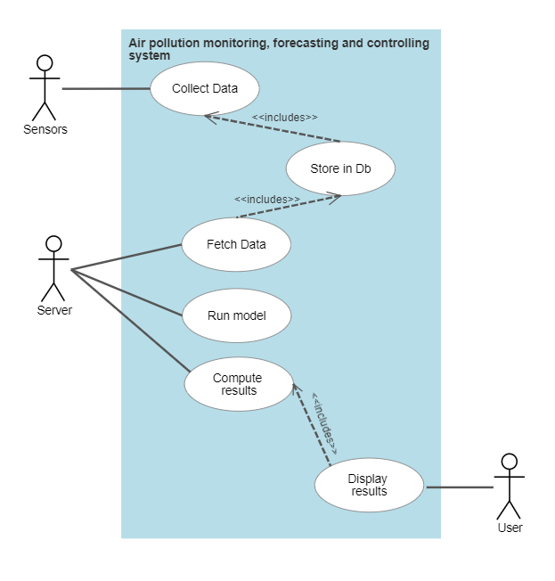
Use Case Diagram

Slide 20
Methodology
Our system has 3 parts:
1. Monitoring
An IoT device will be built using Arduino as the microcontroller. We will use MQ135 Air Quality sensor, MQ131 Ozone sensor, MQ7 Carbon Monoxide sensor, and PM2.5 dust sensor. These sensors will measure the current concentrations of the various pollutants and will output the current AQI. The values of the concentrations of the gases is to be stored in a database, which will be used to forecast the future levels of AQI.
2. Forecasting
Using the data collected in the previous module, an ML model is to be trained to predict the future levels of AQI. Based on the literature survey, the AutoRegression model provided the best results.
3. Controlling
AQI is categorized into 6 categories based on the value. Depending on the category of the current AQI level, suggestions are to be provided to improve the category to ‘Good’.

Slide 21
Technology Stack
Front end
HTML, CSS, JavaScript
Back end
PHP, MySQL Database, Arduino Programming
Machine Learning
Python
Libraries: NumPy, Pandas, Seaborn, Matplotlib, Statsmodels, sklearn

Slide 22
Implementation
Hardware Implementation
Our IoT system consists of MQ135 Air Quality Sensor, MQ131 Ozone Sensor, MQ7 CO sensor, PM2.5 Sensor, Arduino UNO and NodeMCU.
The data collected from the AQI sensor is transmitted via Wifi and stored in our online Database. This data will be pulled from the database and displayed on the website as the current AQI level.
The readings of the other sensors are collected in a .csv format and will be added to the dataset to train the ML model. TeraTerm software is used to transfer the data from the IoT system to .csv file

Slide 23
Implementation
Machine Learning Implementation
The bulk of the data was collected from an open source database, maintained by the Central Pollution Control Board (CPCB). The location of data collection was Jayanagar 5th block and the data collected dated back to June 2018.
That gave us roughly 5 years of data to work with. The data was cleaned to remove anomalies and a monthly average was used to fill in the missing data points.
The basic Machine Learning algorithm used for training the model was AutoRegression. Variants of this algorithm such as ARMA, ARMAX, ARIMA, ARIMAX, SARIMA were explored.

Slide 24
Implementation
Machine Learning Implementation
AutoRegression (AR): An AutoRegressive model is a statistical model which forecasts future values based on past values. Just like how linear models make predictions based upon a combination of independent variables, AR models make predictions based on a combination of past values. This is known as autocorrelation.
Integrated Differencing (I): When the data is non-stationary, this method is performed to make the data stationary. That is, prediction is not made upon the data, rather on the differences between every 2 points of data. This may be done multiple times to remove non-stationarity. However, this is just one of the many methods of making the model deal with non-stationarity. The other methods will be discussed later.
Moving Average(MA): Moving average model denotes that the forecast or result of the model depends linearly on the historical data. Additionally, it implies that predicting mistakes are linear functions of prior errors. Keep in mind that statistical moving averages are not the same as moving average models.
eXogenous Variables(X): These are external variables that may affect the time series forecast. For example, in the case of our modeling, Average Temperature, Diwali, etc. are eXogenous Variables. These alone are insufficient to forecast the values of AQI, however, they contribute indirectly.

Slide 25
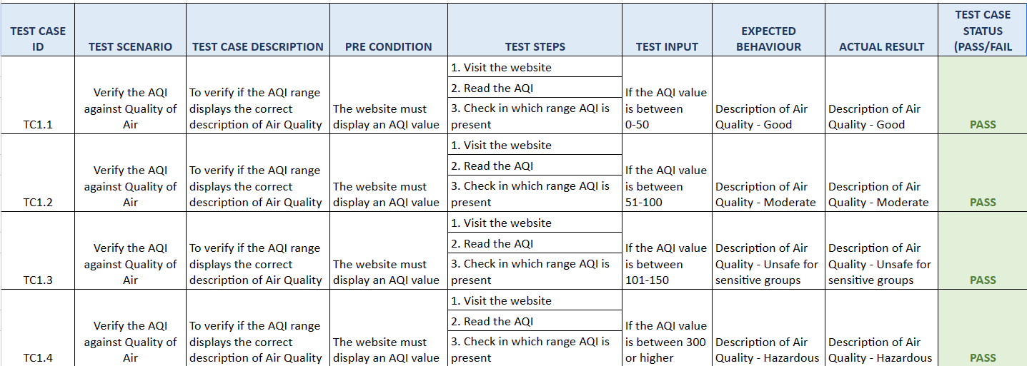
Testing

Slide 26
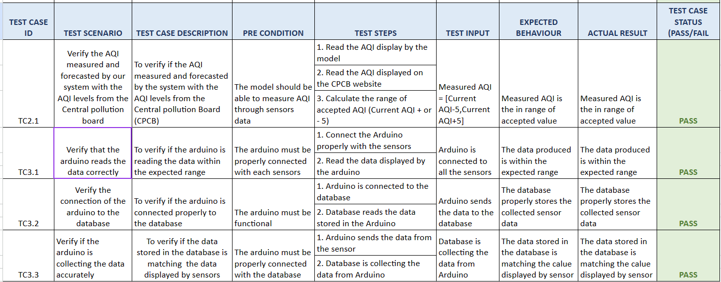
Testing

Slide 27
Results
https://bmsaqiproject.netlify.app/

Slide 28
Results
Model Results:
MODEL (Parameters) | Mean Squared Error (MSE)
Predicting based on previous day | 577.05
AutoReg(lags=17, trend=’t’) | 917.961
ARMA: ARIMA(p=4, d=0, q=1, trend=’t’, exog=Null) | 449.86
ARIMA(p=3, d=1, q=1, trend=’t’, exog=Null) | 450.586
ARMAX(p=4,d=0,q=1, trend=’t’, exog=[‘Average Temperature’]) | 421.21
ARMAX(p=4,d=0,q=1, trend=’t’, exog=[‘Average Temperature’,’Diwali’]) | 220.125
ARMAX(p=4,d=0,q=1, trend=’t’, exog=[‘Relative Humidity’,’Wind Direction’]) | 176.463
ARMAX(p=4,d=0,q=1, trend=’t’, exog=[‘Average Temperature’,’Diwali’,‘Relative Humidity’,’Wind Direction’,’Barometric Pressure’]) | 145.075
ARMAX(p=4,d=0,q=1, trend=’t’, exog=[‘Average Temperature’,’Diwali’,‘Relative Humidity’]) | 125.52

Slide 29
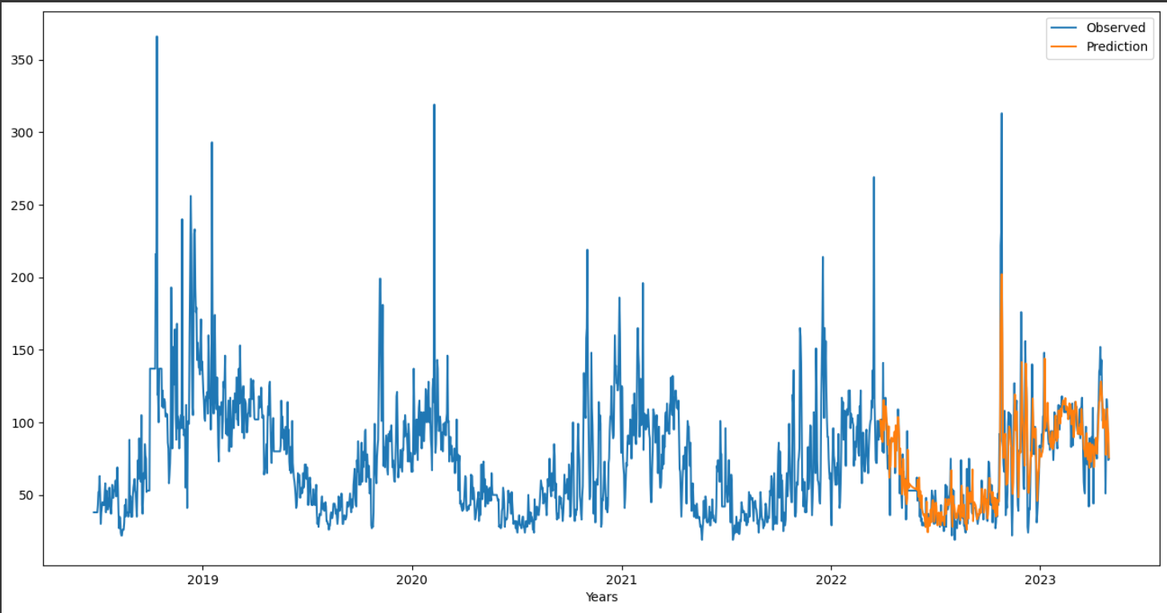
Results
Model Results:

Slide 30
Results
Date | Forecasted AQI(by model) | Actual AQI (from CPCB) | Difference
12/06/2023 | 33 | 35 | 2
13/06/2023 | 33 | 34 | 1
14/606/2023 | 36 | 40 | 4
15/06/2023 | 41 | 45 | 4

Slide 31
Future Enhancement
Integrating the AQI forecast into Google Maps. Just like how Google gives push notifications of the weather rain forecast, it should give AQI forecasts as well.
Automating the complete line of work, the device and model should work without any human interference, except for maintenance.
We have built only one IoT device and have implemented it in only one location. Once we have established the proof of concept with this one location, we hope we can implement this on a much larger scale, covering much larger areas.
Usage of Traffic Density and Industrial Emissions as Exogenous Features.

Slide 32
Project outcome
Competition
KSCST: Selected for ‘Student Project Programme (SPP)’ and received funding
Status: Completed Mid-term evaluation on 5th June 2023.
Selected for final round to be held on August 11th.
Research Paper
Survey Paper accepted in the International Journal of Novel Research and Development (IJNRD)
Awaiting to publish main research paper in IEEE.
Best Project Award
Department of Information Science and Engineering, BMSCE.

Slide 33
Conclusion
Air pollution is a very challenging and complex problem that requires a multifaceted solution. To tackle this complex issue, we are proposing the implementation of a holistic approach to tackle air pollution. Through the proposed system, we not only aim to reduce the levels of air pollution, but also positively impact the lives of people by helping them change their lifestyle in such a way that it will encourage them to adopt some habits that will help reduce air pollution, which will help them, their pets and their environment to be healthier. We are leveraging the capabilities of powerful technologies like IoT and ML to build a system that will fight against the harmful effects of air pollution and make the world a better place to live in.

Slide 34
References
[1] Temesegan Walelign Ayele, et. al “Air pollution monitoring and prediction using IoT'', Inventive Communication and Computational Technologies, 2018.
[2] Ssneha Balasubramanian et al. “Air Pollution Monitoring and Prediction Using IoT and Machine Learning”, IJCSIT, 2021.
[3] T.S. Kitchilan, M.D.B.C.K. Abeyratne et al. “Air Quality Monitoring And Prediction Using IOT And Machine Learning Approaches”, IJSRP, 2022.
[4] Sachin Bhimrao Bhoite et al. “Air Quality Prediction using Machine Learning Algorithms”, International Journal of Computer Applications Technology and Research, 2019.
[5] Saverio De Vito, et al. “Adaptive machine learning strategies for network calibration of IoT smart air quality monitoring devices”, Pattern Recognition Letters, 2020.
[6] Gaganjot Kaur, et. al “Air Quality Prediction: Big Data and Machine Learning Approaches”, International Journal of Environmental Science and Development, 2018.
[7] Dan Zhang, et al. “Real Time Localized Air Quality Monitoring and Prediction Through Mobile and Fixed IoT Sensing Network”, IEEE Access, 2020.

Slide 35
References
[8] Leeban Moses, et al. “IoT enabled Environmental Air Pollution Monitoring and Rerouting system using Machine learning algorithms”, IOP Conference Series, 2020.
[9] Safae Sossi Alaoui et al, “Air pollution prediction through internet of things technology and big data analytics” ,International Journal of Computational Intelligence Studies, 2019.
[10] Tze Wai Wong, et al. “Developing a risk-based air quality health index”, Elesevire, 2012.
[11] Meivel S, et. al “Air pollution monitoring system using IoT and Artificial Intelligence”, International Journal of Modern Agriculture, 2021.
[12] Wenjing Mao, Weilin Wang, Limin Jiao, Suli Zhao, Anbao Liu, “Modeling air quality prediction using a deep learning approach: Method optimization and evaluation”, Elsevier, 2020.
[13] Ramesh P. Singh, et al. “Impact of lockdown on air quality in India during COVID-19 pandemic”, Springer Nature B.V., 2020.
[14] Anindya Ananda Hapsari, et al. “A Review on Indoor Air Quality Monitoring using IoT at Campus Environment”, International Journal of Engineering and Technology, 2018.

Slide 36
References
[15] Somansh Kumar, “Air Quality Monitoring System Based on IoT using Raspberry Pi”, IEEE, 2017.
[16] Nimisha Tomar, et al., “Air Quality Index Forecasting using Auto-regression Models”, IEEE, 2020.
[17] Anikendar Kumar, et al.“Forecasting of daily Air Quality Index in Delhi”, Elsevier, 2012.
[18] Suling Zhu, et al., “Daily Air Quality Index forecasting with hybrid models: A Case in China”, Elsevier, 2017.

Slide 37

12

Slide 38

13

